Slide 1
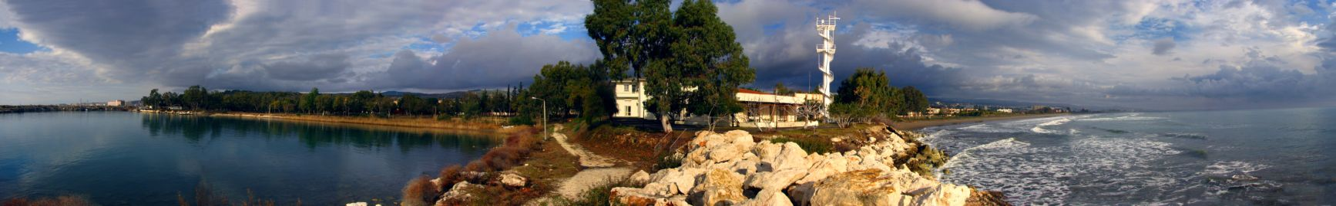


A Review of the Levantine Basin Circulation and Modeling of the Asia Minor Current
On the occasion of the 25 years of POEM
Emin Özsoy, Ali Aydoğdu,
Adil Sözer, Hazem Nagy
Institute of Marine Sciences,
Middle East Technical University,
Erdemli, Mersin

Slide 2
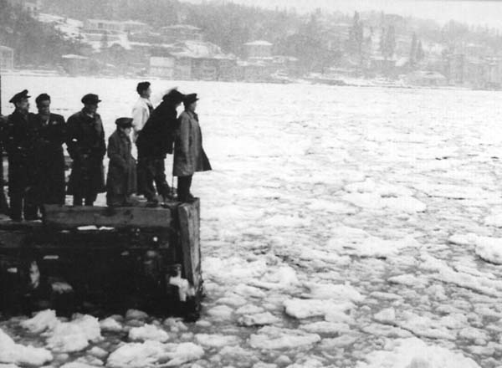
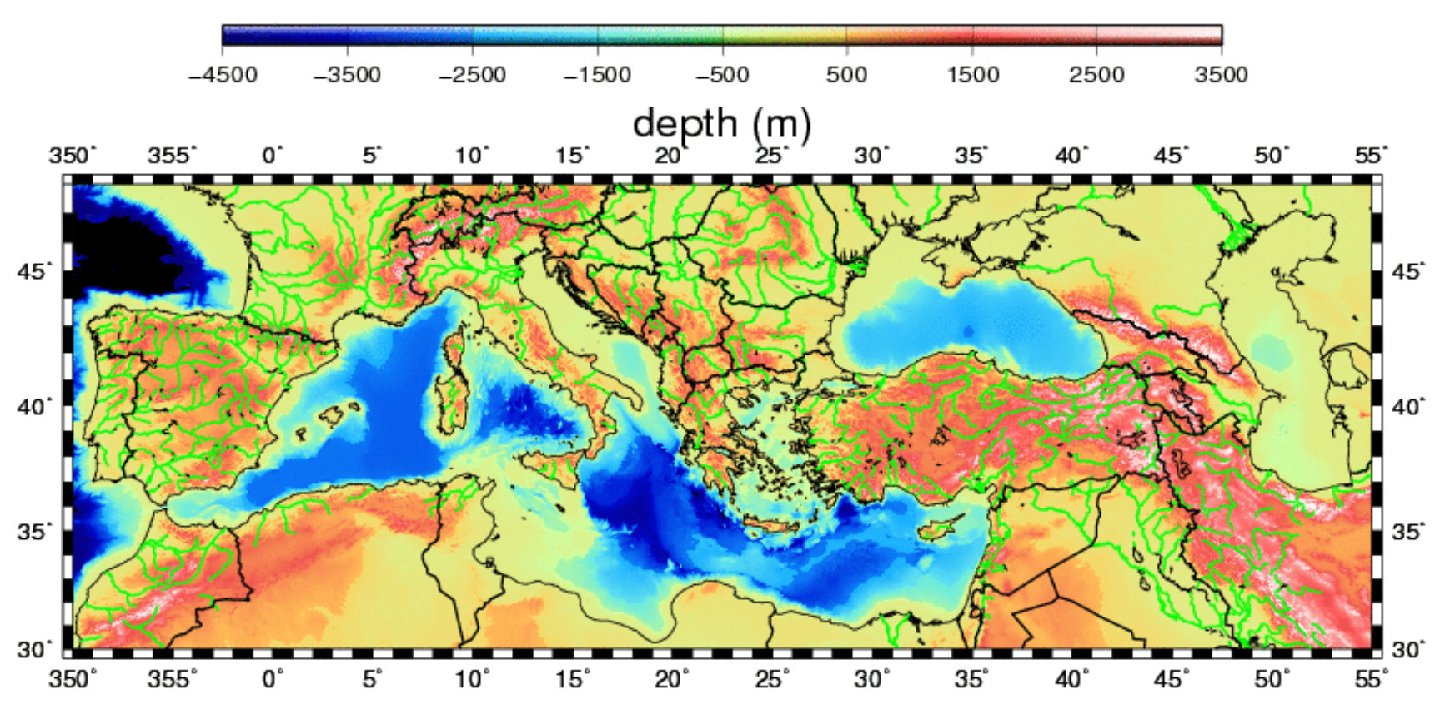
Seas of the Old World
Persistent observations needed in regions of high climate variability (Mediterranean,
Black and Caspian Seas)

Slide 3
NATO Projects
Black Sea (3), Caspian Sea
European Projects
Ventilation of the Black Sea, Aral Kum,
MFS, MFSTEP, IASON, ECOOP, SESAME, PERSEUS,
MyOcean, MyOcean2, MyOcean Follow On,
Copernicus Marine Environment Monitoring Service
(CMEMS)
+
many TÜBİTAK projects
including MOMA (kamu)

Slide 4
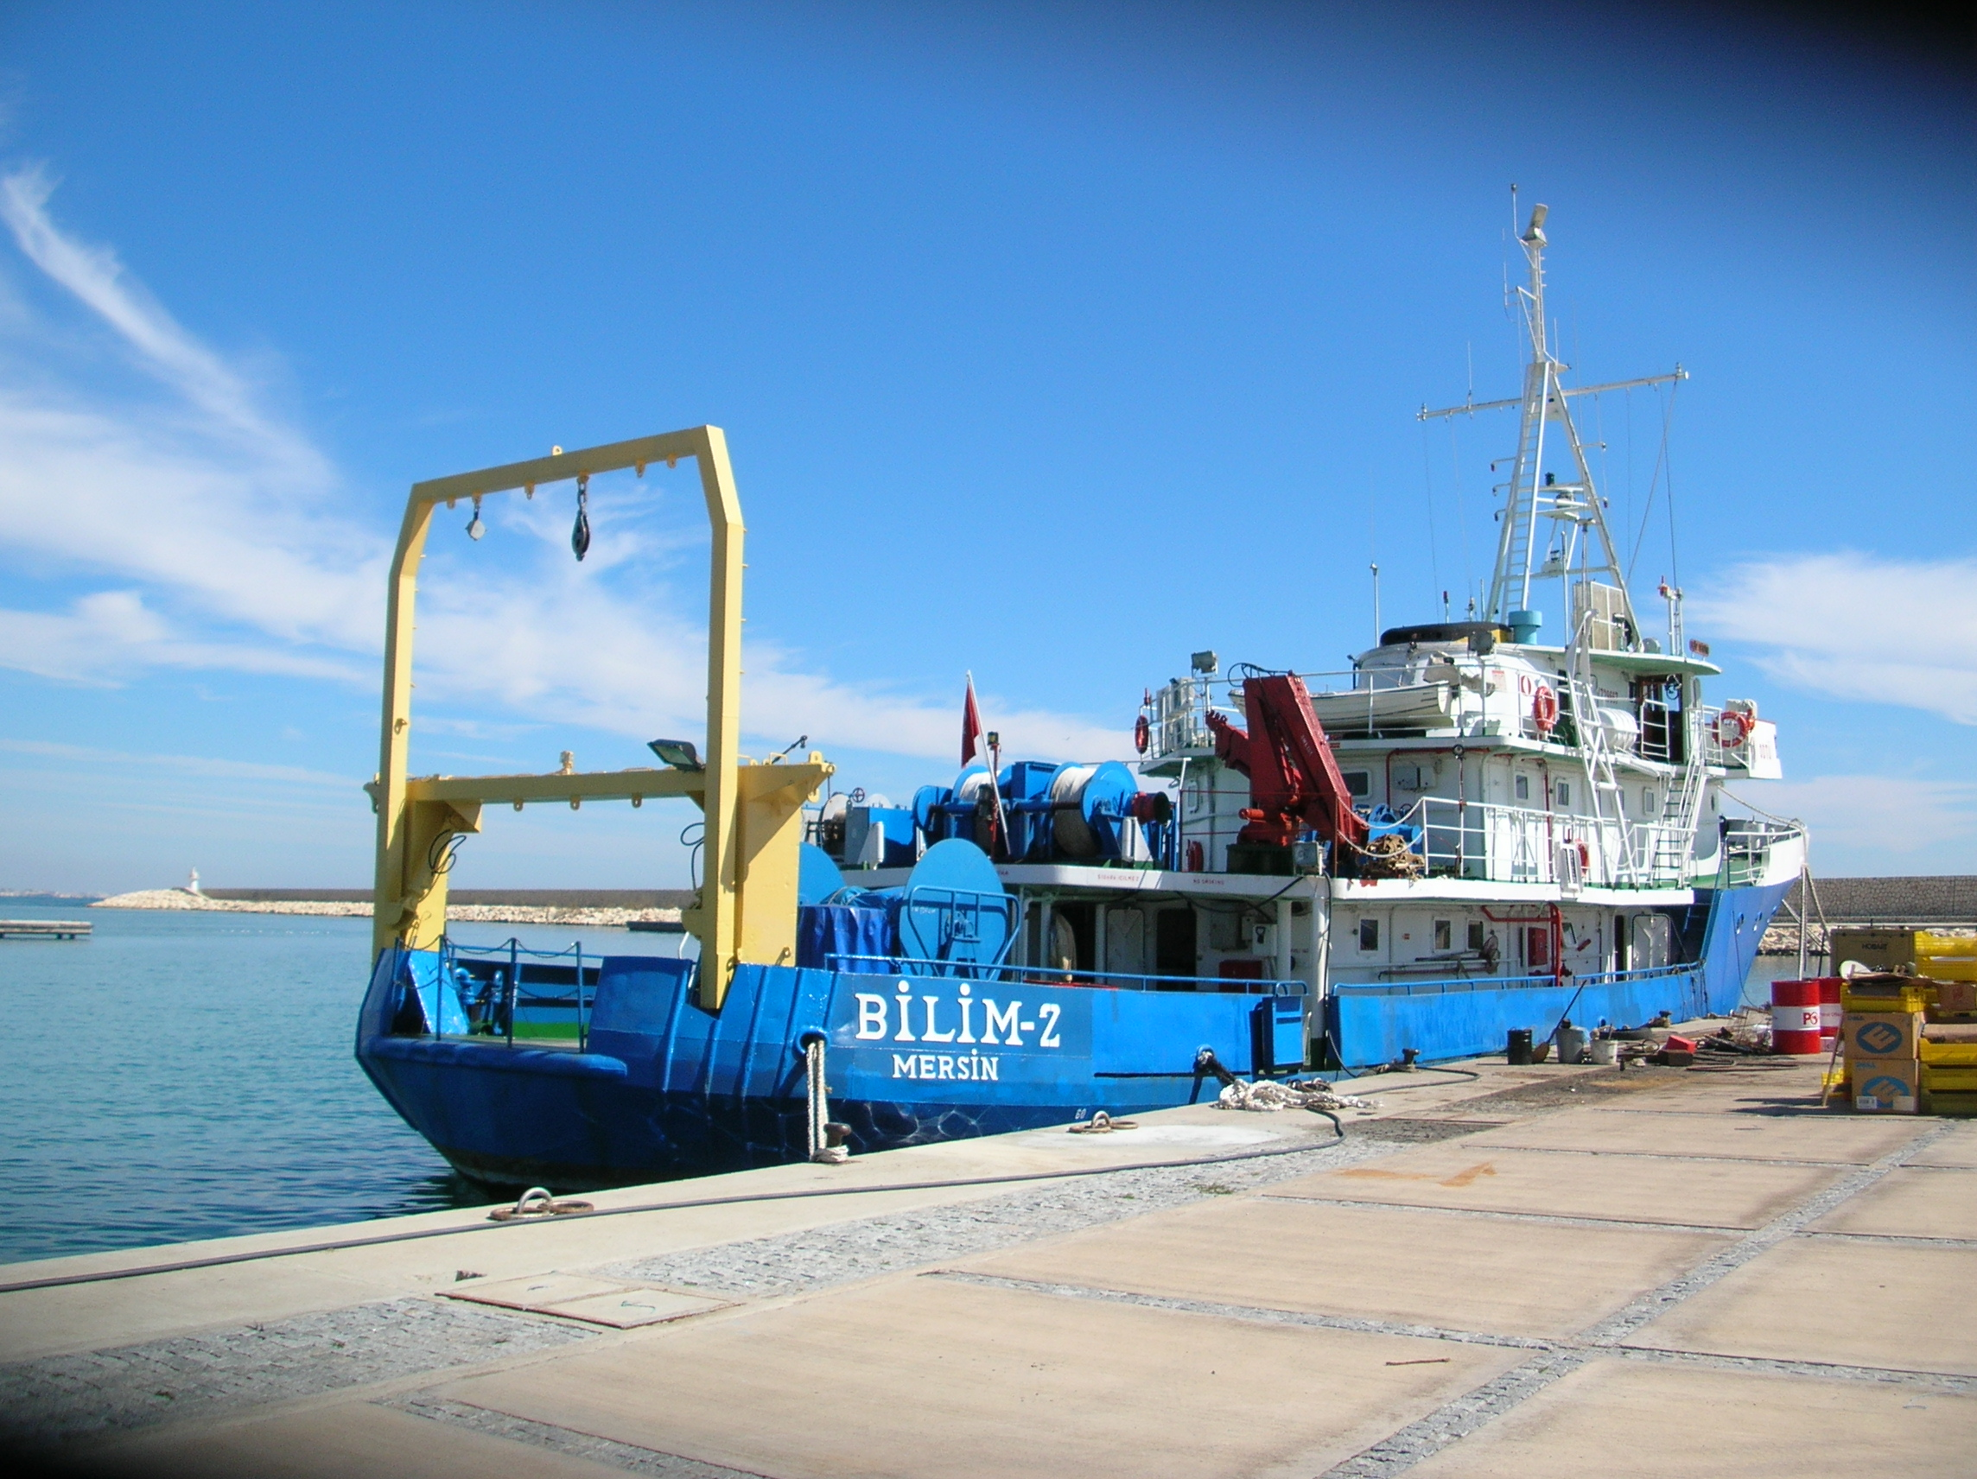

Slide 5
Coasts of Turkey to the Mediterranean
Levantine Basin, Aegean Sea,
Black Sea,Turkish Straits System:
Forcing - semi-enclosed seas - multi-scale (micro to climate):
wind stress, wind setup, storm surge
heat / salt / material fluxes / atmospheric transport
water and buoyancy fluxes, water balance R+P-E
- sea level, hydrologic cycle
- barometric pressure
Time scales:
Bosphorus: Transit time < 1/2 day
Dardanelles: Transit time ~ few days
Black Sea: residence time 1yr for CIL, >2000yr for bottom
Marmara Sea: residence time 3mo for upper, 6yr for lower layer
Mediterranean: residence time ~100 yr

Slide 6
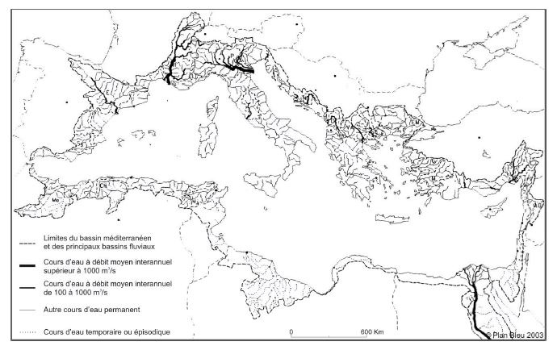
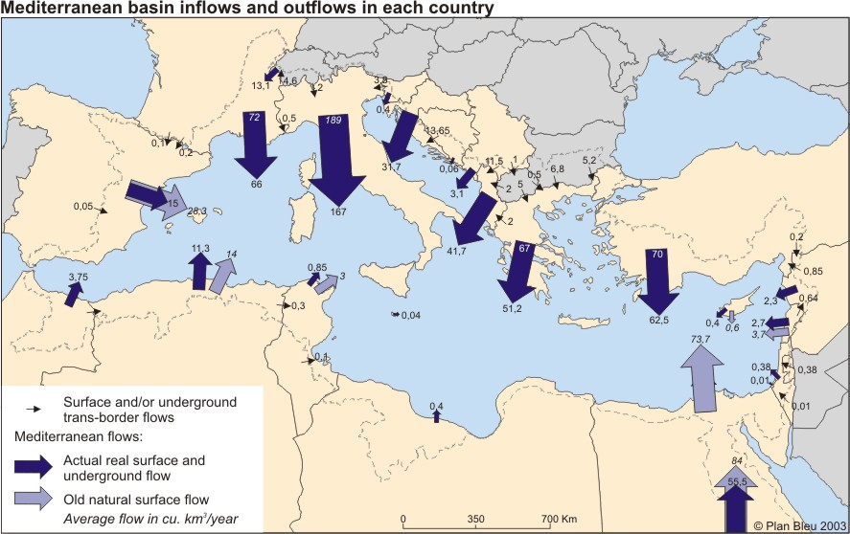
Thickness of lines indicative of
relative size of river discharge
Mediterranean catchments:
north side: very narrow, but mountain sources abundant
south side: even narrower and dryer, with the exception of the Nile, intercepted by the Aswan high dam after 1960s
Fresh water inputs into the Mediterranean Sea from riparian countries in km3/yr (Plan Bleu)
Dark blue arrows: existing surface and underground flows
Light blue arrows: surface flows that have ceased to exist

Slide 7
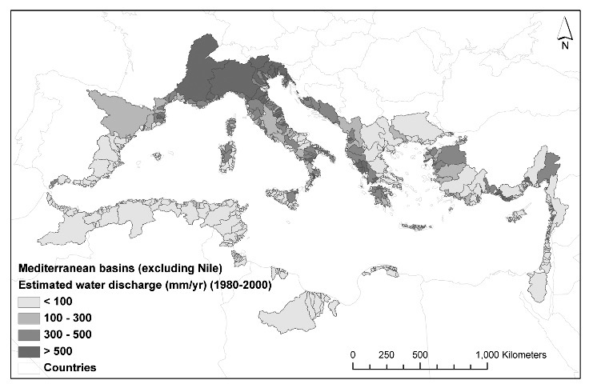
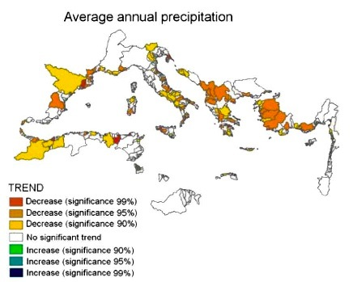
runoff to the
Mediterranean
excluding the
Nile river
Bouraoui
et al., 2009
Changes in the
runoff

Slide 8
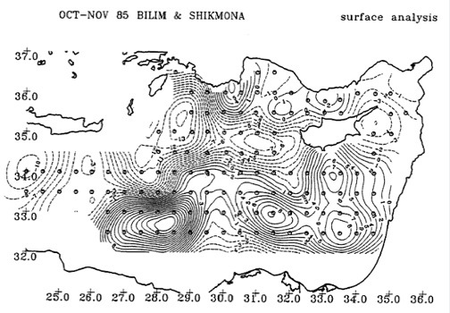
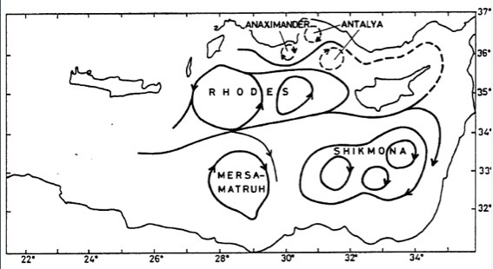
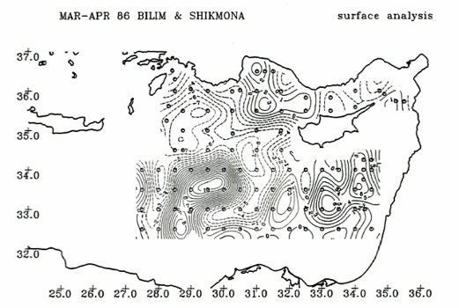
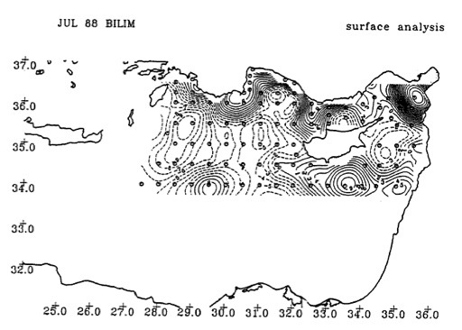
POEM 1985-1991
Özsoy et al. 1989
Asia Minor Current
1991 POEM BC -> ???

Slide 9
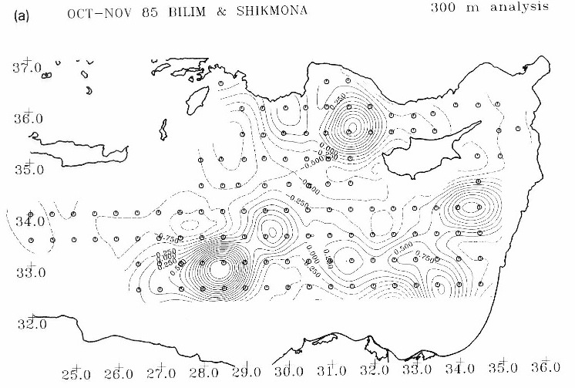
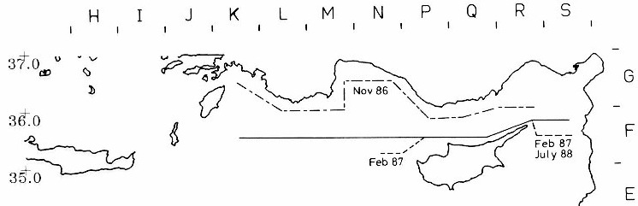
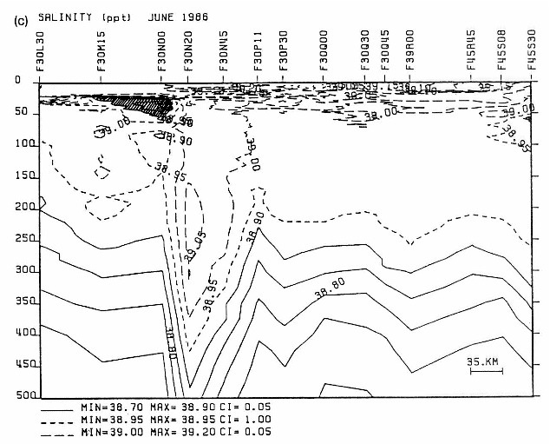
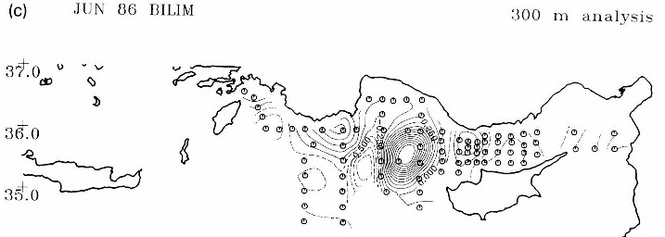
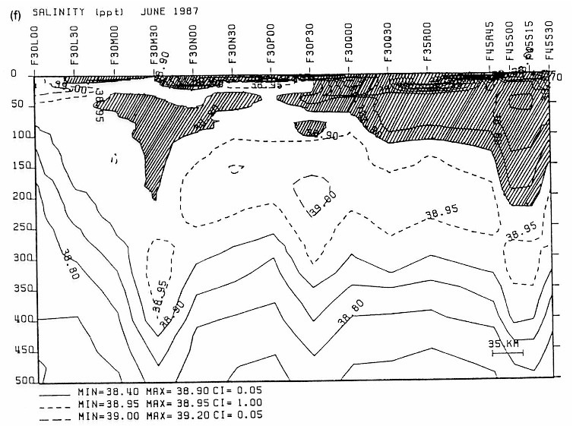
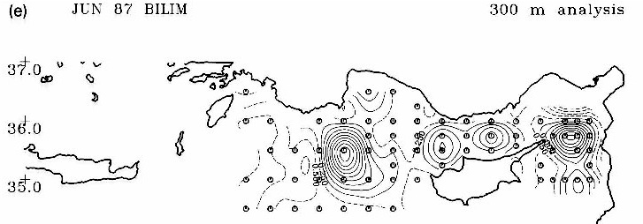
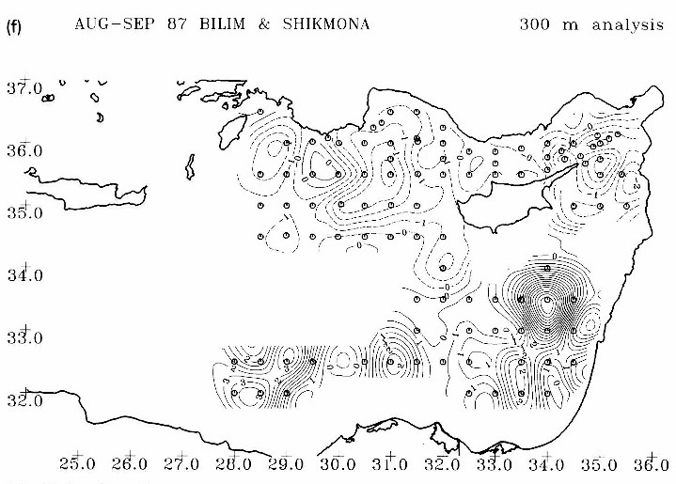
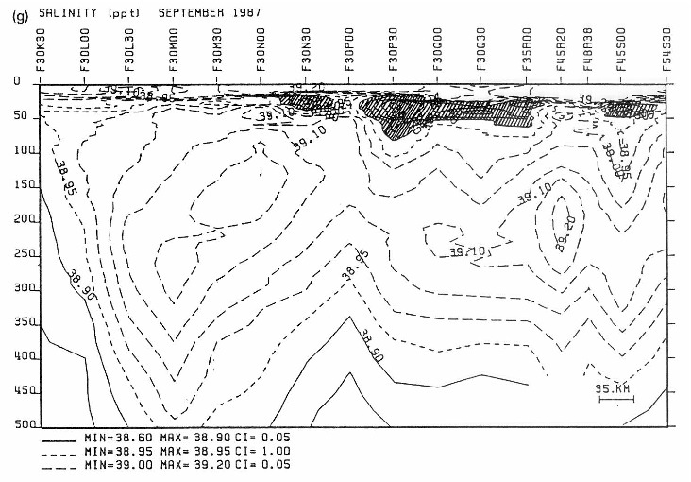

Slide 10
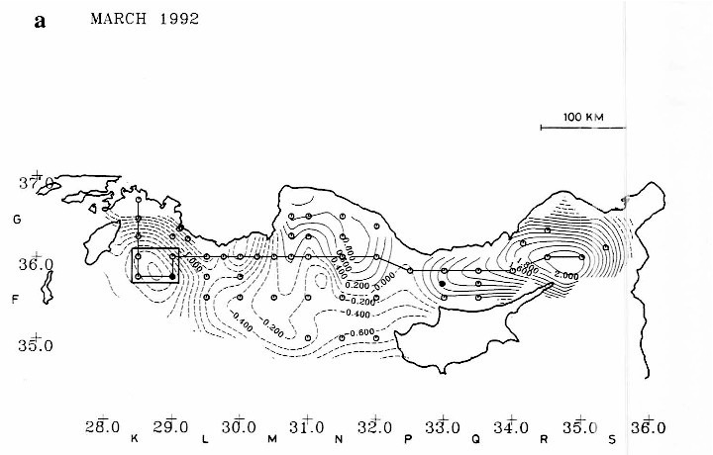
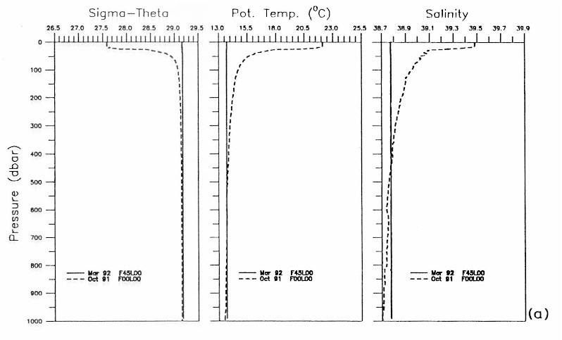
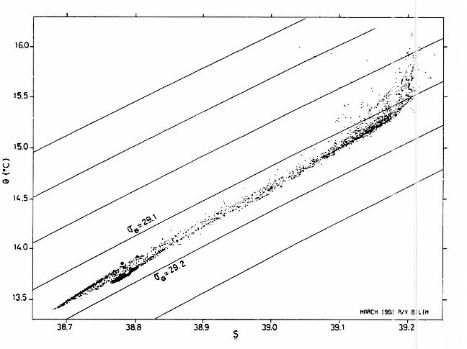
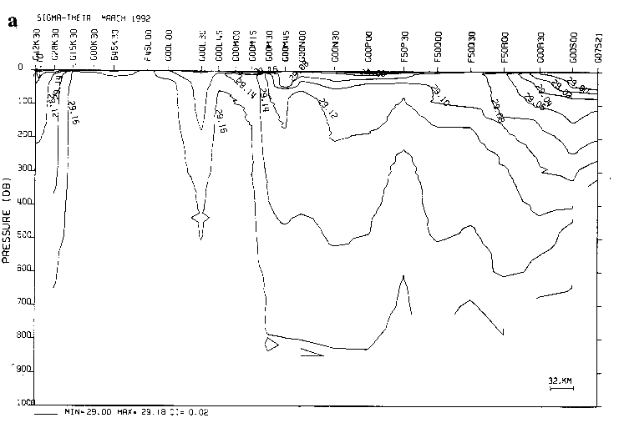
Sur et al., 1992. Simultaneous deep and intermediate depth
Convection in the Northern Levantine Sea, Winter 1992

Slide 11
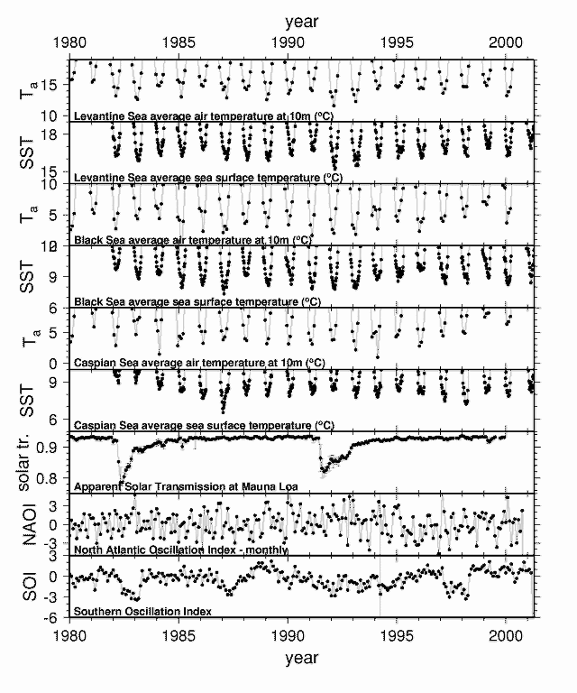
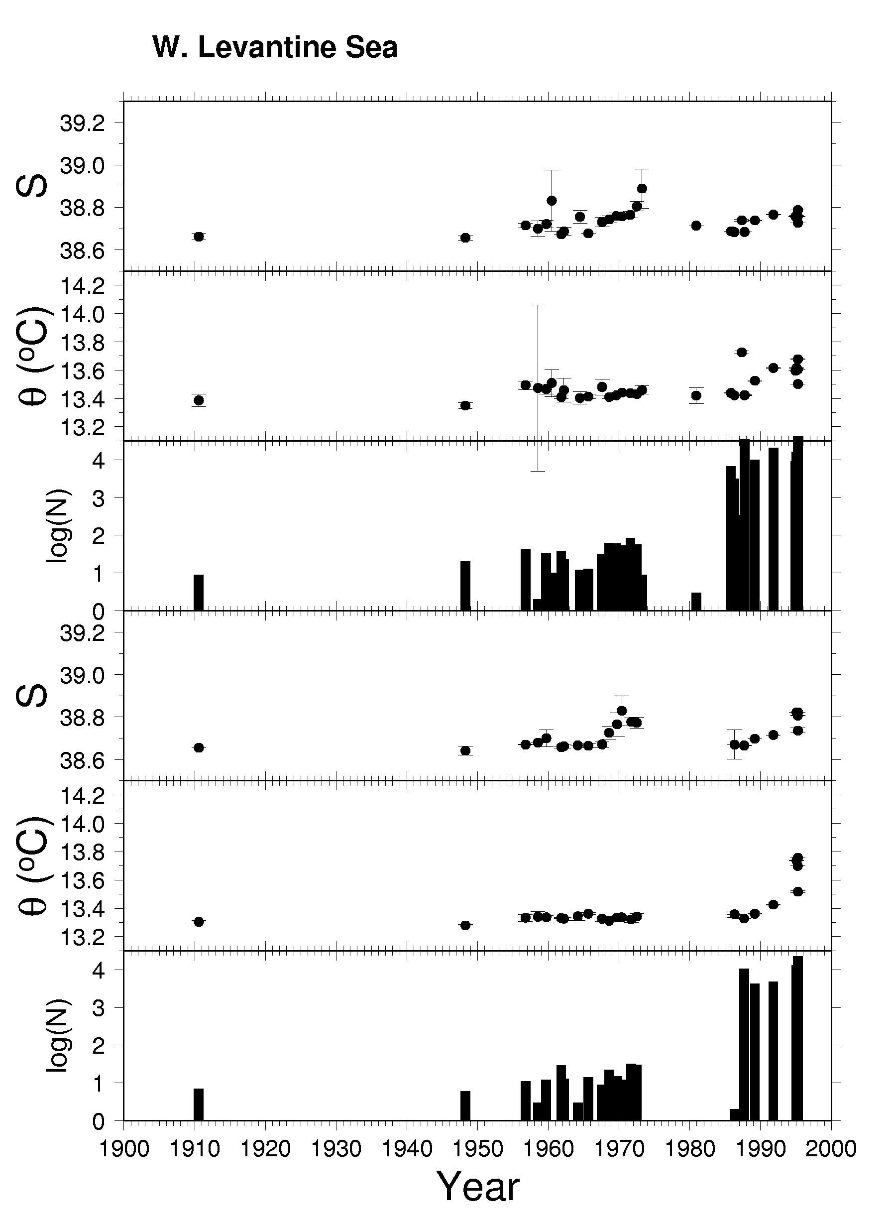
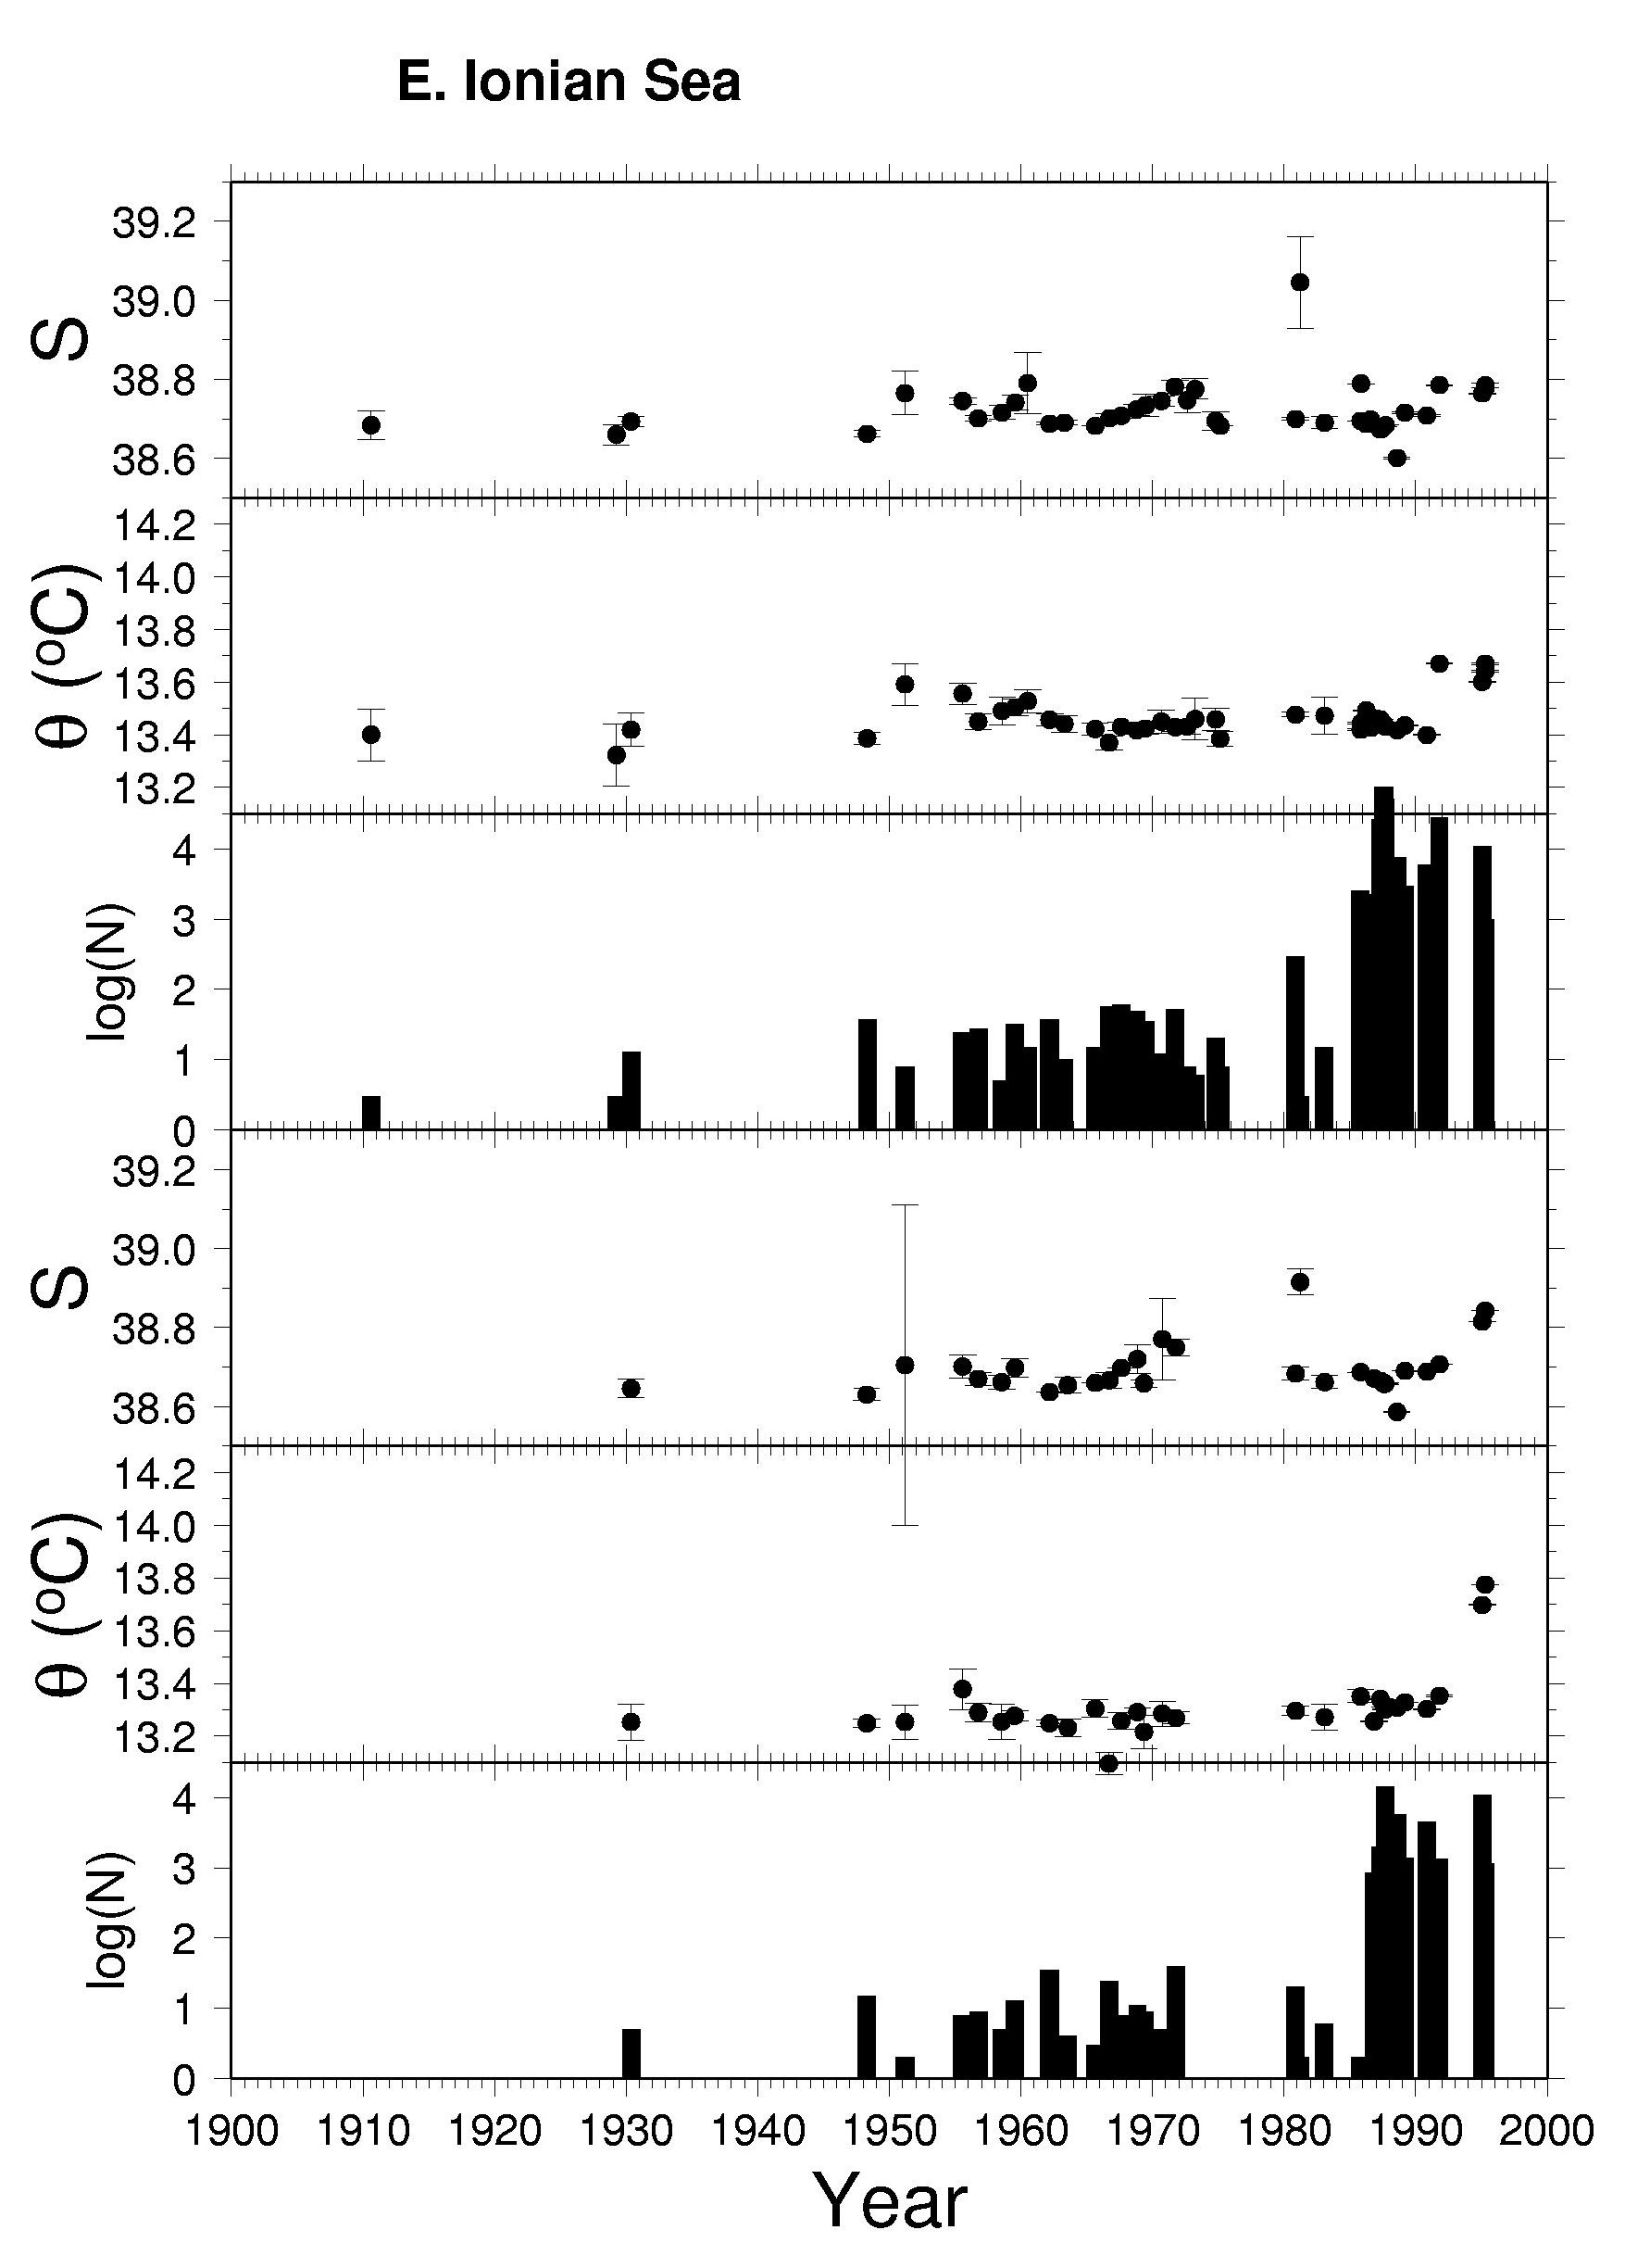
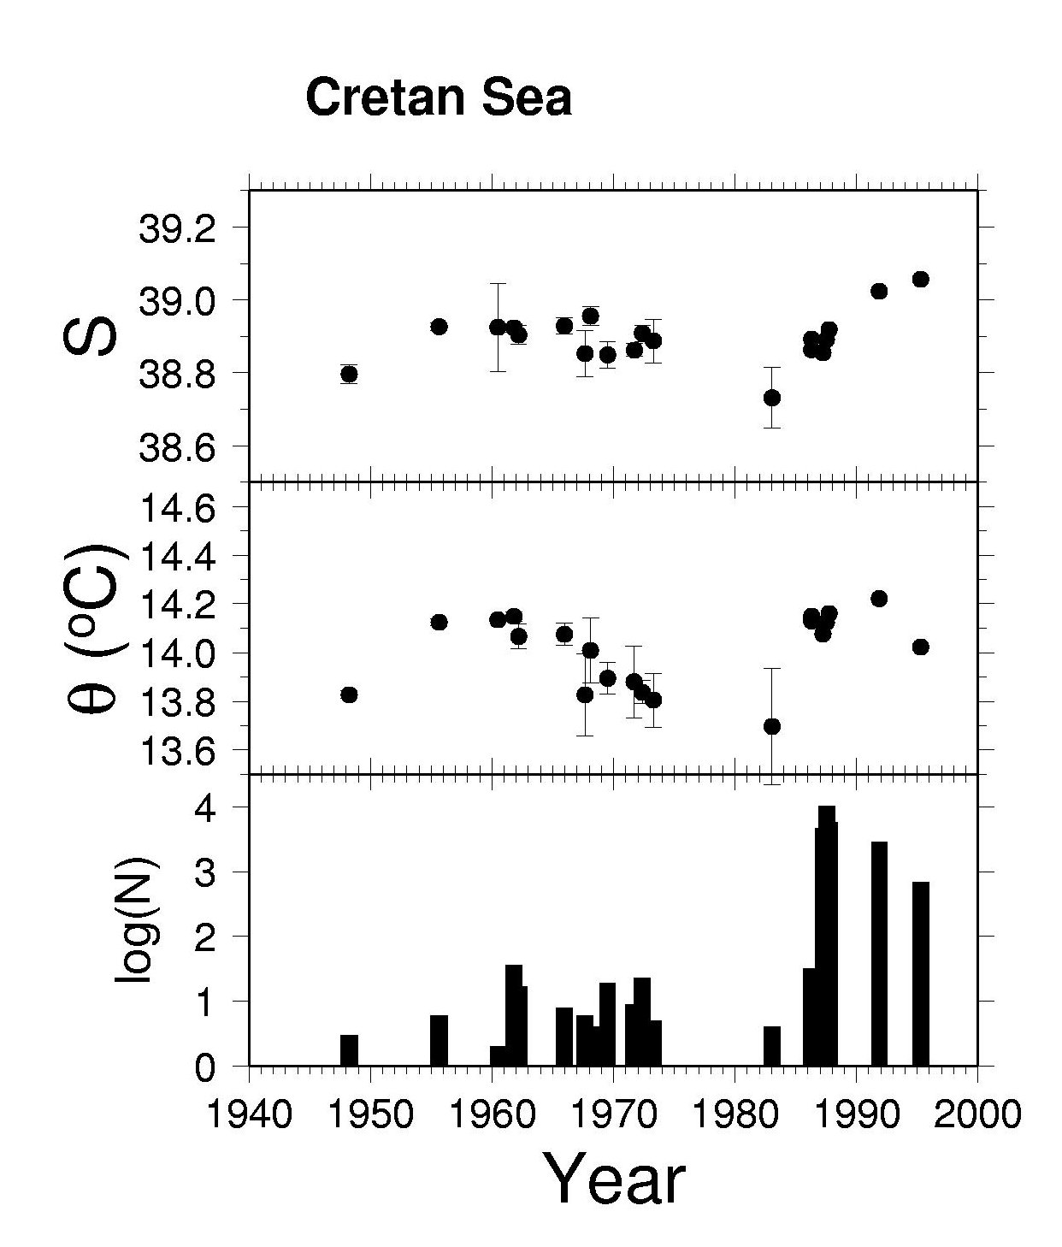
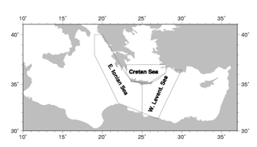
1000-2000m
Cretan Sea 500-1000m
2000-4000m

Slide 12
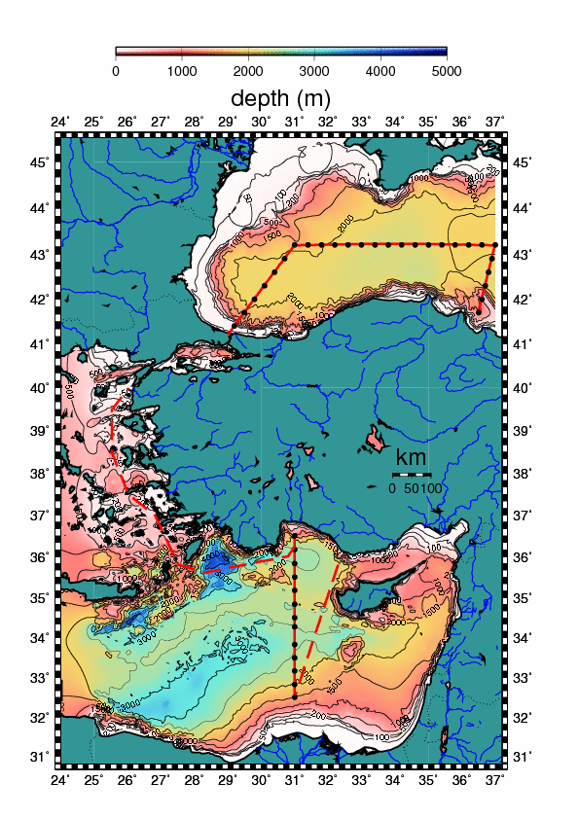

SESAME EU Project
R/V BİLİM
Ümit Ünlüata Cruises
April – September 2008

Slide 13
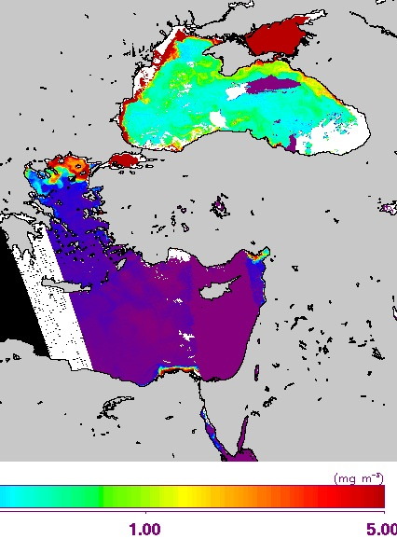
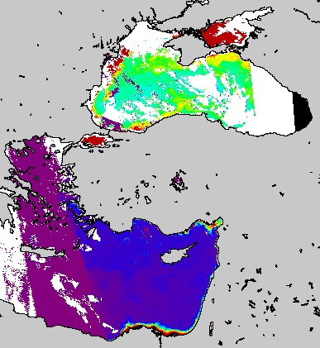
Satellite chlorophyll

Slide 14
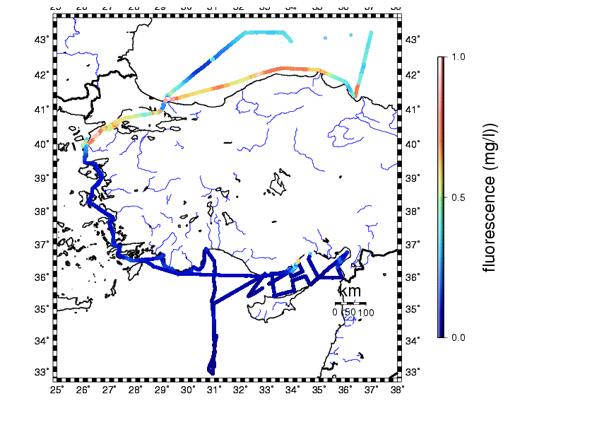
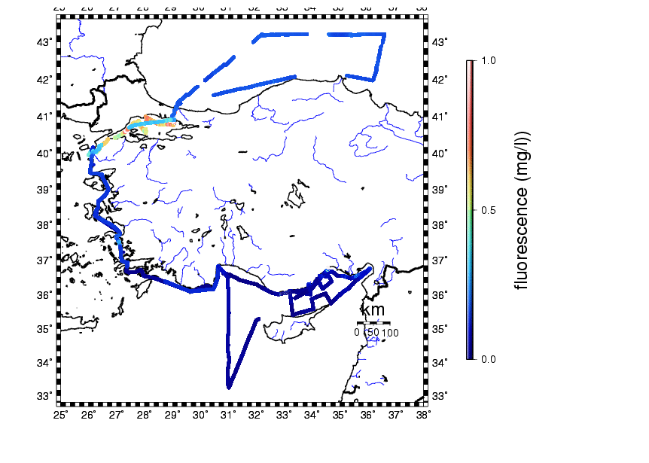
Chlorophyll fluorescence - Sesame Ünlüata cruises

Slide 15
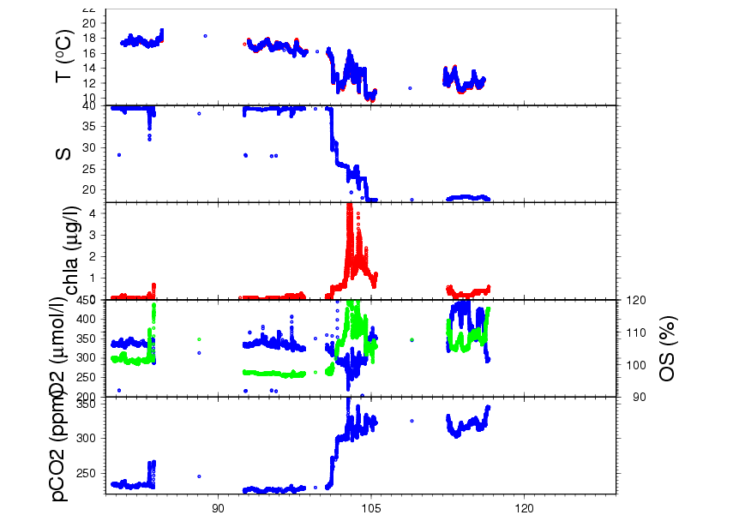
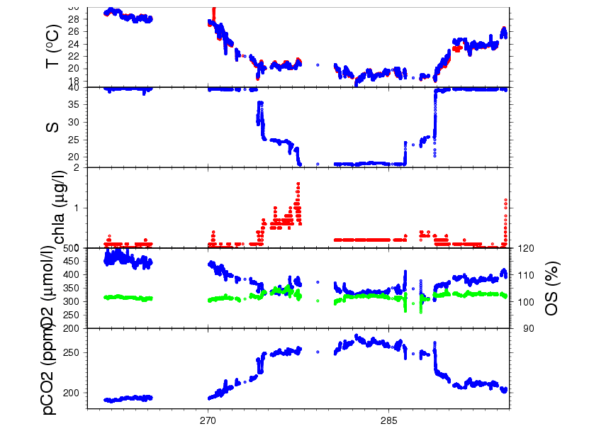
EU Project Sesame
Ümit Ünlüata cruises
October 2008
April 2008

Slide 16
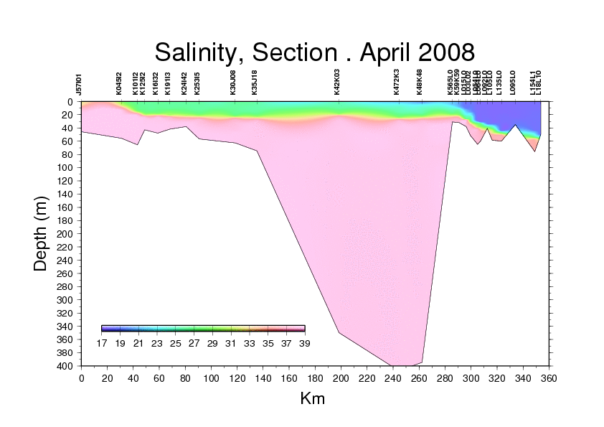
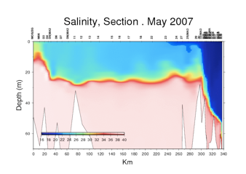
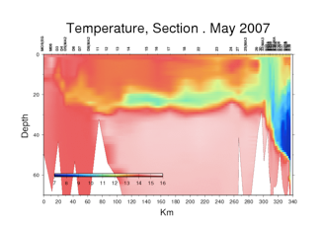
Turkish Straits System / northern Aegean Sea exchange
MCIW
CIW
MW
Aegean Dardanelles Marmara Bosphorus Black
Sea Strait Sea Strait Sea
Dardanelles Straits
Marmara Sea
Marmara Sea
Marmara Sea
Bosphorus Straits

Slide 17
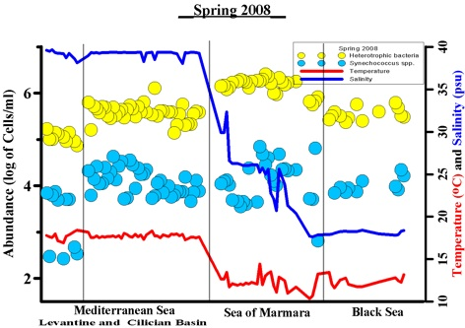
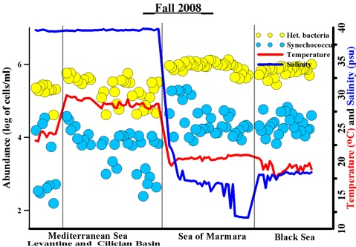
Heterotrophic bacteria and Synechococcus
Variation across basins
Heterotrophic bacteria, Synechococcus (log scale !), temperature and salinity
Changes from the Cilician - Levantine Basin to the Black Sea and through the Turkish Straits System

Slide 18
Carbon sequestration and air-sea exchange
T, S, chla, O₂, pCO₂ From Levantine Sea to Black Sea
and through theTurkish Straits System
Mar08
Sep08
Cilician B Levant TSS Black Sea Cilician B Aeg TSS Black Sea Levant

Slide 19
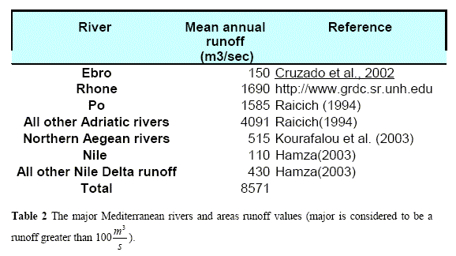
Driver of Mediterranean coastal ecosystems: River inputs 274 km3/yr
After Pinardi et al, The Sea, v.14
Levantine Basin: shortage of fresh water - shortage of nutrients
South: Nile discharge decrease after 1960’s:
~ 6-15 km3/yr – Ludwig et al, 2009
(formerly ~ 83km3/yr at Aswan)
North: Göksu, Lamas, Tarsus, Seyhan, Ceyhan, Asi rivers
contribute 28 km3/yr into the Cilician Basin.

Slide 20
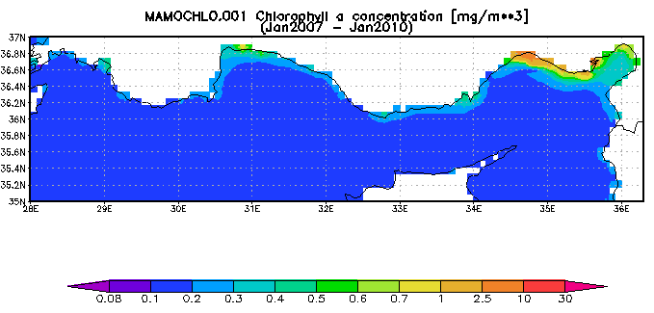
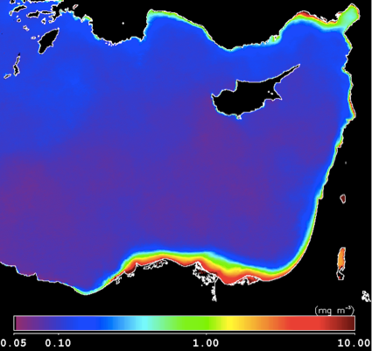
satellite
mean
chlorophyll
Rivers
Eşen,Manavgat,
Göksu, Seyhan,
Ceyhan, Asi
(north)
Nile
(south)
Rhodes Gyre
Eastern Med:
Blue desert ?

Slide 21
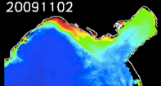
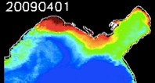
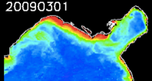
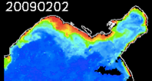
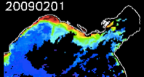
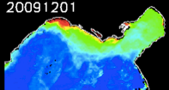






Cilician Basin - Mersin Bay and Gulf of İskenderun
4 major rivers - Göksu, Seyhan, Ceyhan, Asi + streams supply
fresh water, nutrient, wastewaters in an otherwise oligotrophic sea

Slide 22


Slide 23


Levantine Basin Circulation Features:
“Rhodes” (permanent gyre)
“Mersa Matruh”, “Shikmona”, “Cyprus”, “Antalya”, “Ierapetra”
(quasi-permanent eddies)
“mid-mediterranean jet”
“Asia Minor Current”
shelf
sill
Cilician Basin - ROFI
“region of freshwater influence --- but --- in an oligotrophic sea of high contrast”
Cyprus – Gulf of İskenderun “Strait”

Slide 24

Satellite observations

Slide 25



Region of
River Influence
Eddy dispersion

Slide 26

Özsoy, E., Lozano, C. and A. R. Robinson, (1992).
A Baroclinic Quasigeostrophic Model for Closed Basins or
Semi-Enclosed Seas with Islands, Math. Comp. Simul.,
34, 51-79.
POEM - Physical Oceanography of the Eastern Mediterranean

Slide 27

MFTEP MODELS HIERARCHY

Slide 28




Cilician daily forecasts - MFSTEP Project
Resolution 1.35 km

Slide 29




Currents and salinity inJanuary 2003 SVP
At 10m, 100m, 500m and 800m depths

Slide 30




Asia Minor Current
Northern Levantine Sea forecast system - res: 1.35 km
(POM)

Slide 31



European Operational Oceanography - along the footsteps of ARR
INGV MFS
ALERMO resolution
1/50 degrees ~ 2.2 km
NLEV res. 1.35 km

Slide 32

Pinardi et al. (2011). The Mediterranean Large Scale Low Frequency
Ocean Variability from 1987 to 2007, A Retrospective Analysis

Slide 33

NLEV ROMS model: SESAME and MyOcean Projects
resolution 1.35 km in x and y, 30 s-levels in vertical
Large et al (1994) K-profile turbulence parameterization (LMD)
open boundary conditions 2drad,chapman+flather,T,S,u,v
surface atmospheric fluxes - INGV-SXG model scenario
lateral inputs: volume,T,S,NO3,NH4 at 14 rivers and streams
coupled ecosystem model - Bio_FennelNLEV
Northern Levantine Basin
Multi-year coupled ecosystem model simulations
(1996-2001) and (2030-2035 IPCC A1B)
Nested in OGS Mediterranean Sea model

Slide 34





Sea-level difference ~ net transport
Taşucu
Taşucu-Girne
Taşucu
Girne
Girne

Slide 35




Dense water (LIW) formation in the Gulf of İskenderun
operational
Model
MyOcean
observation

Slide 36

LEV Levantine basin model – ROMS 1.35 km, operational soon

Slide 37









Dec 97
Winter mix.
Feb 98
Mar 98
Apr 98
Spring bloom
Rivers +
Rhodes Gyre
May 98

Slide 38


chlorophyll
MODIS
Mar 98
Model

Slide 39




NO3 Feb 10, 1998
Chl-a Feb 10, 1998
NO3 Apr 05, 1998
Chl-a Apr 05, 1998

Slide 40



1996-2001
chlorophyll
surface avg
red - bc
blk - model
phytoplankton
surface avg
red - bc
blk - model
zooplankton
surface avg
red - bc
blk - model
overpredicted !
overpredicted !

Slide 41
Discussion:
Observational and predictive model systems should go hand in hand in
highly variable systems, especially in the age of climate change
Persistent long term observations combined with model predictions
contributing to a better understanding of the complex Eastern
Mediterranean system
Basic circulation features of the Levantine basin foreseen in POEM
are confirmed by model-data syntheses: sub-basin scale gyres, jets,
Intense currents, coherent eddies, multi-mode circulation cells,
oscillations, Impulse response to strong events better monitored by
better equipped / integrated ocean science community
rivers in the coastal areas, eddy dispersion and new production
in the open sea (esp. Rhodes Gyre area), maintain productivity of the
Ecosystem in the Levantine basin, which seem to be more effective to
Distribute material distribution from the coastal areas to the open sea
possible shelf pump modes of material transport in shallow
continental shelf areas created by dense water (LIW) formation
need extensive validation of properties, mixing, productivity

Slide 42
and, thanks!

